Slide 1
A Time-turner & A Muse
Maximizing Productivity, Eliminating Distractions, & Increasing Flow
Soquel Baumgardner
Notes:
Welcome to "A Time Turner and a Muse with Soquel Baumgardner"
Because it's impossible to cram 48 hours into our day, we've got to prioritize our most valuable commodity: time
This class will discuss ways that we as writers can be more productive in less of it without feeling stressed out
The result will be finding the ideal time to write for our personal chronotypes, training our families and others to respect our writing time, and implementing fair workload practices

Slide 2
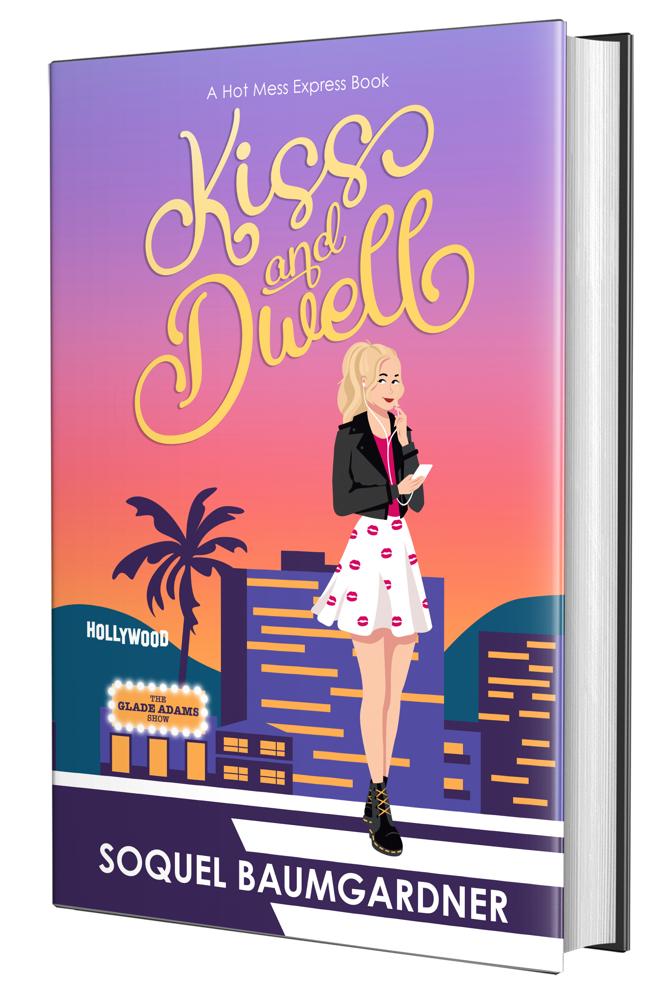
https://www.soquelbaumgardner.com/writing-conference-materials
A shameless plug for my newest book available in the conference bookstore and at book retailers everywhere. Come say hello at the mass book signing tonight!

Slide 3
A Precious and Finite commodity
23
.15
4,000 Weeks
“Time = Life; therefore, waste your time and waste your life, or master your time and master your life.” Alan Lakein
Notes:
Time is finite – once spent it is gone. Due to the limited nature of time we need to manage it wisely by effectively prioritizing tasks to achieve writing goals while balancing other life commitments.
Myth busting time: There is no such thing as multitasking. We’re task juggling machines and the best we can do is group like tasks together. Research shows students switched between tasks every 65 seconds, Adults switch about every 3 minutes! Why? Because it’s nearly impossible for us to pay attention anymore. Switching tasks requires mental energy as we are often switching between the sides of our brain. It takes more executive reasoning, and we get tired quickly. The human brain cannot do more than 3 tasks at a time and two of them must be of a more mindless type. i.e. I can listen to an audiobook while putting together a digital puzzle and chewing gum. Impressive right? Another example would be sorting and folding laundry while watching TV. Note: You can not do this well if you are watching a K-drama and don’t understand the language. It will tax your executive functioning too much.
Focus is precious and hard to maintain. When we focus, we achieve flow state. When interrupted it takes a minimum of 23 minutes and 15 seconds to get that focus back. To put that into perspective in a typical 8 hr. workday, employees only perform around 3 hrs. of focused work. Imagine how much better we’d focus if we could go home after getting our work done! Some companies are working towards that very concept right now. Consider the math of lost productivity:. Add up those 23-minute chunks over the course of a day, and you're hemorrhaging valuable time.
Exploring Challenges Faced by Writers: Juggling writing projects with work, family obligations, and personal responsibilities. Emphasize the importance of recognizing and addressing these challenges to maintain productivity and well-being. We all have times when procrastination, distractions, and feel overwhelmed. Let’s explore some creative ways to manage our time and increase our productivity by staying in flow.
"4,000 Weeks" is a thought-provoking book by Oliver Burkeman that explores the concept of time management in the context of mortality. It challenges readers to reconsider their approach to time and offers insights and strategies for living a more fulfilling and meaningful life.
Prioritization: "4,000 Weeks" emphasizes the importance of prioritizing activities that align with one's values, goals, and sense of purpose. Burkeman suggests identifying the most meaningful and impactful tasks and dedicating time and energy to them while letting go of non-essential distractions and obligations.

Slide 4
The Formation of Good Habits
Habit Tracking & Habit Stacking
The Four Laws of Behavior Change: Cue, Craving, Response, and Reward form the foundation of habit formation and offer actionable techniques for applying these principles to create lasting habits.
Habit Stacking: Anchor new habits to existing routines or behaviors to leverage the power of context and make habit adoption easier.
Habit Tracking: Measure progress and success to maintain accountability and motivation Maintain motivation and stay on track with habit goals through self-awareness and by using public commitment strategies, such as posting progress updates on social media or sharing goals with friends and family.
Implementation Intentions: Set specific “If-Then" plans to anticipate potential obstacles and plan appropriate responses, increasing the likelihood of habit adherence.
Environment Design: Shape the environment to support desired behaviors and minimize temptations and distractions that may derail progress, creating an environment that increases convenience and is conducive to habit formation and success.
Notes:
The Four Laws of Behavior Change:
Law 1: Make it Obvious (Cue): Create obvious cues or triggers that prompt desired behaviors and make them more automatic and effortless.
Law 2: Make it Attractive (Craving): Explore ways to make habits more attractive by linking them to rewarding experiences or aligning them with personal values and identity.
Law 3: Make it Easy (Response): simplify the process of habit formation by breaking tasks into smaller, manageable steps and removing barriers or friction that hinder behavior change.
Law 4: Make it Satisfying (Reward): Provide immediate and satisfying rewards for desired behaviors to reinforce positive habits and encourage repetition.
Designating specific times and locations for habit implementation to create cues and triggers that prompt automatic action. Example: refill water bottle and dance for three minutes during your Pomodoro 5-minute break.
Make your path known

Slide 5
Creative Approaches to Time Management
Non-Traditional Methods
Writing exercises on steroids: ‘Morning Pages’, timed sprints, applying tips from NanoWrimo.
Minimizing Distractions
Ideas to restore our stolen focus and tap back into a deep flow state.
Role of Mindfulness and Intentionality
Benefits of mindfulness practices for enhancing focus on writing goals and reducing stress.
"Time is not just a series of minutes ticking by; it's a canvas waiting for us to paint our priorities. Creative time management means not just managing minutes, but crafting moments that align with our deepest desires and goals." Johann Hari, Stolen Focus
Notes:
Stolen focus refers to the diversion of attention from a task or activity due to external stimuli or internal thoughts, leading to decreased productivity and cognitive overload.
Common sources of stolen focus include digital distractions like smartphones and social media, environmental distractions such as noise and clutter, and internal distractions like intrusive thoughts and worries.
Stolen focus can disrupt workflow, hinder concentration, and impair decision-making, ultimately leading to decreased efficiency and performance in various aspects of life.
Common causes of stolen focus include triggers of distraction, such as notifications from electronic devices, multitasking, information overload, and environmental factors like noise and interruptions.
It effects mental health, productivity, and well-being, including reduced attention span, heightened stress levels, diminished creativity, and decreased job satisfaction.
Beware the feedback loop: where distractions lead to negative outcomes, which in turn perpetuate further distractions, creating a vicious cycle that can be difficult to break without intervention.

Slide 6
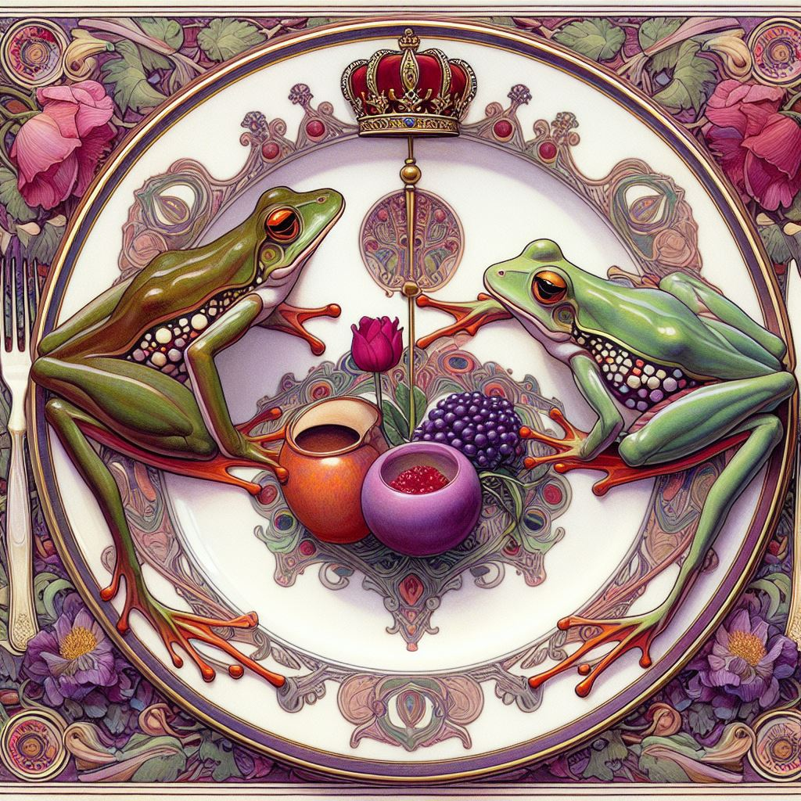
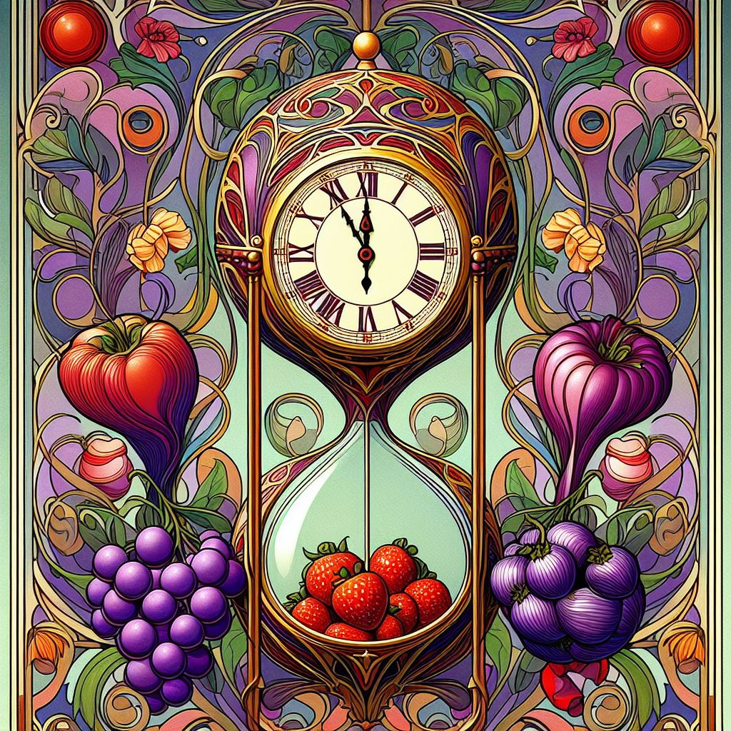
Non-Traditional Approaches
Eat a big frog for breakfast. Eat another for second breakfast. Yum, frog legs!
Prioritizing tasks and allocating time effectively by scheduling Pomodoro sessions for each task or project and tracking progress throughout the day. Hint: Use YouTube videos to keep time and inspire your writing.
Breaking larger projects into smaller, more manageable components and tackling them one Pomodoro at a time, leading to steady progress and a sense of accomplishment
Implementing time-saving techniques such as batching similar tasks together to improve workflow efficiency and minimize context switching (it taxes executive functioning.)
Pareto Principle: also known as the ”80/20 rule”, which suggests that 80% of results come from 20% of efforts. Apply this principle to identify high-leverage activities and allocate time and resources accordingly.
Partnering with an accountability buddy or joining a support group to share progress, provide encouragement, and hold each other accountable.
Using public commitment strategies, such as posting progress updates on social media or sharing goals with friends and family, to increase accountability and motivation to follow through on habit commitments. Make your path known!
Notes:
Introduction to Non-Traditional Methods: Explore unconventional approaches to time management that prioritize creativity and well-being. Discuss techniques such as time blocking, Pomodoro technique, and batching tasks to increase efficiency and focus.
Non-Traditional Methods: Example: Describe the "write or die" technique, where writers set a timer and commit to writing without interruption for a set period. This unconventional approach can help writers overcome procrastination and perfectionism.
Pareto Principle: also known as the 80/20 rule, which suggests that 80% of results come from 20% of efforts. Apply this principle to identify high-leverage activities and allocate time and resources accordingly.
Time Management Strategies: Tracy provides practical time management strategies for prioritizing tasks, such as creating to-do lists, setting goals, and using techniques like time blocking and the ABCDE method to prioritize tasks based on importance and urgency.
Eat That Frog!" is a bestselling book by Brian Tracy that offers practical strategies for overcoming procrastination, improving time management, and achieving greater productivity.the metaphor of "eating the frog," which represents tackling the most challenging or important task first thing in the morning to increase productivity and momentum throughout the day.
It’s all right to go old school and use traditional methods too. Utilize tools and technologies such as task management apps, calendar reminders, and time-tracking software to streamline processes and stay organized. There’s some great ones out there for minimizing distractions too. We’re going to talk about that next.

Slide 7
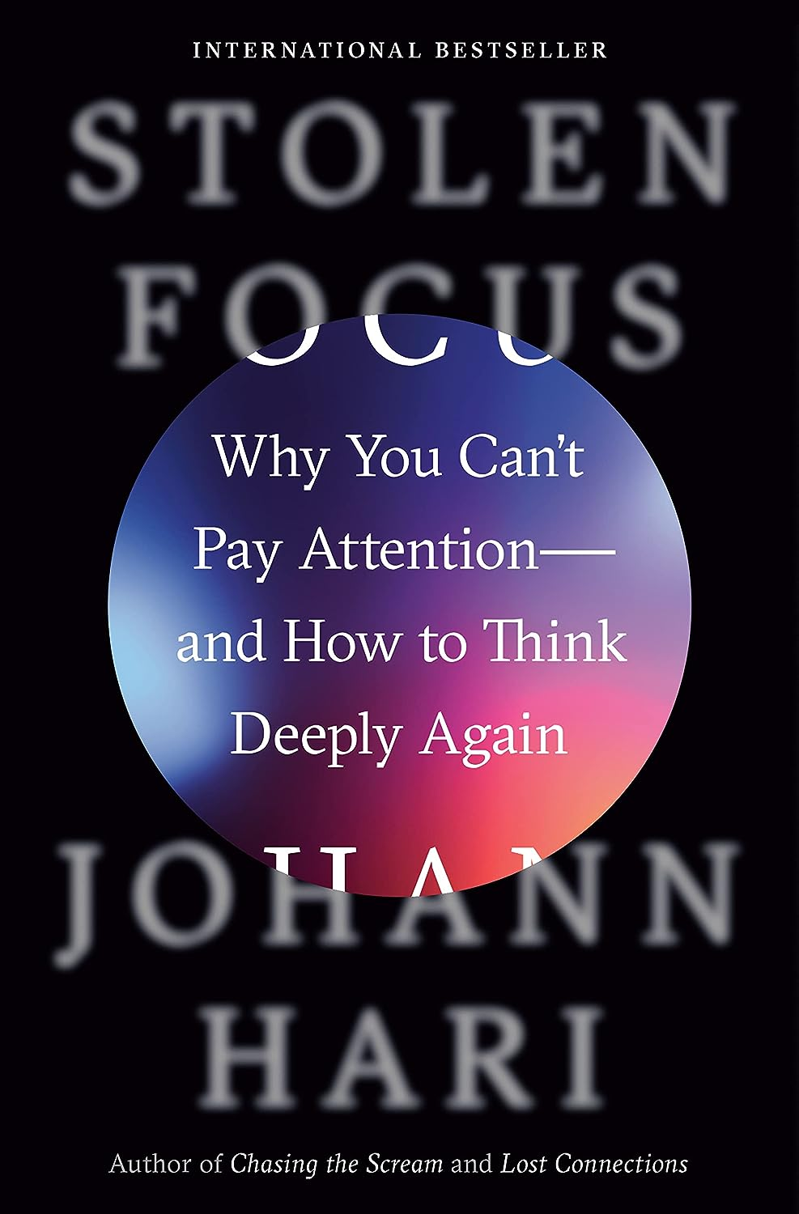
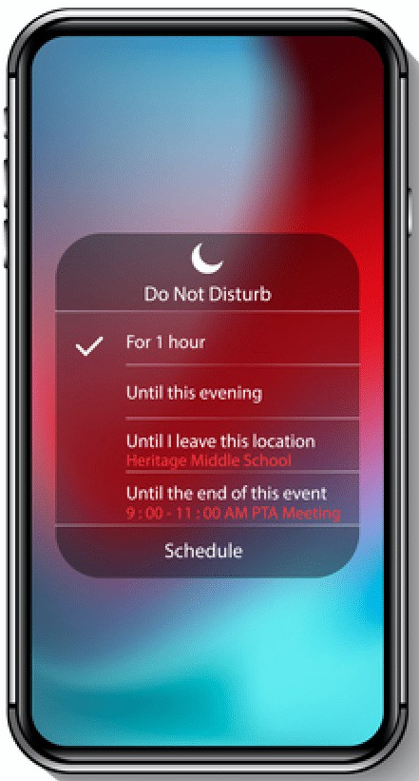
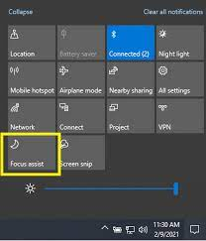
Minimizing distractions
"two-minute rule" deal with small tasks immediately to prevent them from piling up and becoming distractions later.
“ABCDE method” prioritizes tasks based on importance and urgency.
Practical time management strategies for prioritizing tasks, such as creating to-do lists, setting goals, and using techniques like time blocking.
“the 80/20 rule”, where writers spend 80% of their time on essential tasks and 20% on leisure and self-care activities.
“Write or Die" technique, where writers set a timer and commit to writing without interruption for a set period.
Maintain strong boundaries and recognize the signs of burnout to prevent long-term negative effects on creativity and well-being.
"work-life balance wheel," where writers assess and prioritize different areas of their life such as work, family, health, and hobbies.
Use DND, noise cancelling headphones, and delete all unnecessary apps from your phone.
Have “office hours” for answering emails, texts, and returning phone calls. Unsubscribe from newsletters you don’t read.
Notes:
Provide recommendations for productivity apps like Freedom or StayFocusd to block distracting websites during writing sessions

Slide 8
Cultivating Mindfulness & Presence with intent
Practicing Niksen by sitting quietly and observing the world around you without any specific goal or purpose, allowing thoughts to come and go without judgment. Daydreaming while performing repetitive tasks such folding laundry, knitting, or martial arts forms and yoga poses.
Embracing stillness and reflection by engaging in activities that provide mental or physical refreshment, such as listening to music, journaling, practicing deep breathing ,meditation, or visualization to enhance focus and concentration.
Achieving a state of flow while painting, becoming completely absorbed in the creative process, losing track of time and self-awareness.
Creating unicorn space by going for a walk in nature without any distractions, allowing the mind to wander freely and explore new ideas and perspectives.
Notes:
Role of Mindfulness and Intentionality: Discuss the importance of mindfulness in managing time and staying present during writing sessions. Encourage writers to cultivate a mindful approach to their work, focusing on the task at hand and letting go of distractions and worries.
Role of Mindfulness and Intentionality: Explain how mindfulness practices such as meditation, journaling, or gratitude exercises can help writers cultivate awareness and intentionality in their daily routines. Share research findings on the benefits of mindfulness for reducing stress, enhancing focus, and improving overall well-being. Recommend incorporating short mindfulness exercises or breathing techniques into writing routines to promote mental clarity and creativity.
Living with Purpose: Burkeman encourages readers to reflect on their values, passions, and long-term aspirations and to align their actions with their sense of purpose. He suggests cultivating a sense of meaning and fulfillment by engaging in activities that contribute to personal growth, connection, and well-being.
Mindfulness: "4,000 Weeks" promotes mindfulness as a tool for cultivating awareness, presence, and intentionality in everyday life. Burkeman encourages readers to pay attention to their thoughts, emotions, and behaviors, and to cultivate mindfulness practices such as meditation, journaling, or gratitude exercises to enhance focus and clarity.
Niksen is the Dutch and Danish practice of doing nothing, characterized by embracing moments of idleness, stillness, and relaxation without any specific purpose or goal.
Origins and Cultural Significance: Niksen reflects the Scandinavian philosophy of hygge and the Dutch concept of "niksen," which emphasize the importance of slowing down, savoring the present moment, and finding contentment in simplicity.
Niksen offers numerous benefits for mental and emotional well-being, including stress reduction, enhanced creativity, improved focus, and greater resilience to burnout.
Niksen can be practiced in various ways, such as taking short breaks throughout the day to pause and breathe, spending time in nature, engaging in leisurely activities like reading or listening to music, or simply allowing oneself to daydream and be present in the moment.

Slide 9
Cultivating Creativity and Productivity: Flow
Setting aside time each day for creative pursuits, such as writing, painting, or playing music, to nurture and develop creative skills. Creating a daily routine that includes periods of focused work interspersed with breaks for rest and relaxation, optimizing productivity and creativity. Surrounding oneself with inspirational quotes, artwork, and objects that spark creativity and serve as reminders to stay focused and motivated.
Flow is a psychological state characterized by complete absorption in an activity, where individuals experience deep focus, heightened concentration, and a sense of effortless control.
Flow is essential for enhancing creativity, productivity, and overall well-being, as it allows individuals to fully engage with their tasks and experience a sense of fulfillment and satisfaction.
Individuals in a state of flow have clear objectives and a sense of purpose, which helps to focus their attention and guide their actions.
Flow experiences provide immediate feedback on performance, allowing individuals to adjust their actions in real-time and maintain a sense of progress and mastery.
Flow occurs when the level of challenge presented by the task matches the individual's skill level, leading to a state of "flow channel" where challenges are neither too easy nor too difficult.
Flow is characterized by intense concentration and absorption in the present moment, with individuals losing track of time and external distractions.
Notes:
Embracing passion and purpose: Encourage individuals to pursue activities that align with their passions and values, as these are more likely to lead to flow experiences and a sense of fulfillment.
Implementing digital detox days where technology use is limited, allowing for more meaningful connections with others and opportunities for creativity to flourish.

Slide 10
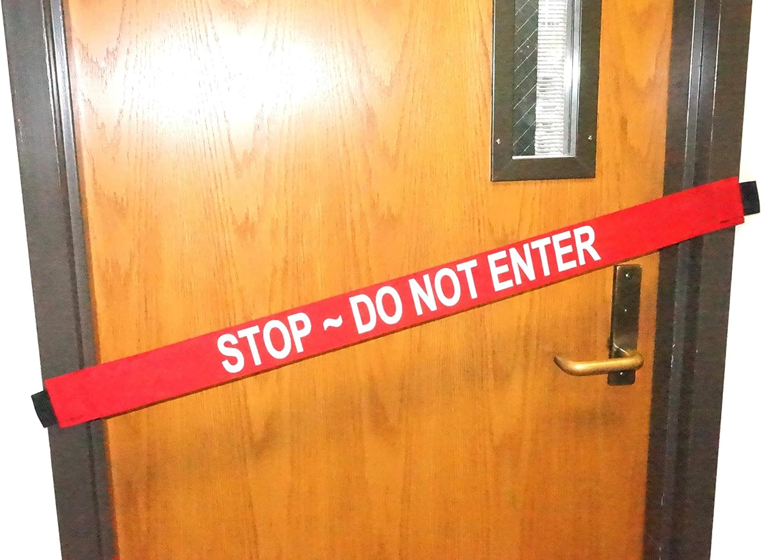
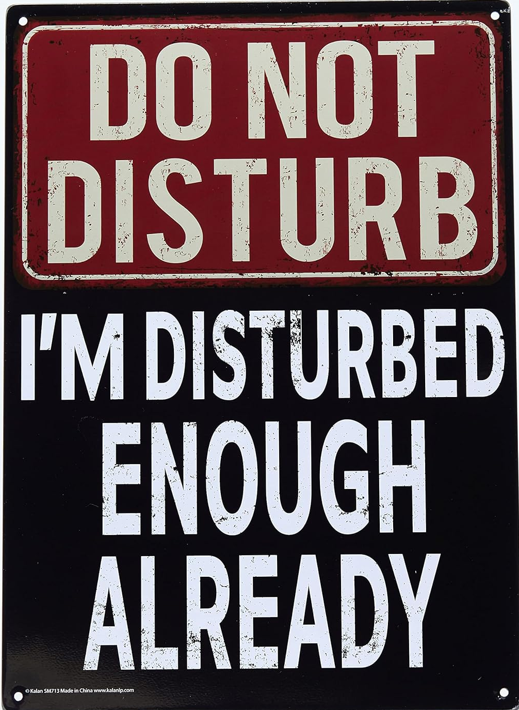
Establishing Boundaries & Protecting your writing time
Set Clear Boundaries: Clearly communicate with family, friends, and colleagues about your writing schedule and the importance of uninterrupted time for creative work. Establish specific boundaries around when you are available for non-writing related activities and stick to them consistently.
Learn to Say No: Prioritize your writing goals and politely decline requests or invitations that conflict with your writing time. Understand that saying no to non-essential commitments is necessary to protect your writing time and maintain focus.
Create Physical Boundaries: Designate a dedicated writing space where you can work without distractions. Use physical cues such as closed doors or noise-canceling headphones to signal to others that you are in writing mode and should not be disturbed.
Notes:
Set Clear Boundaries and stick to them: J.L. Esplin, a member of my writing group will frequently bow out of weekday writing activities to protect her writing time. She readily comes to evening events.
Learn to say no: Stress is what happens when you gut screams no and your mouth says I’d love to!
Create Physical boundaries: If necessary, stop showering or string barbwire along your cubicle.
Schedule Writing Sessions: Block out specific time slots in your calendar dedicated solely to writing. Treat these writing sessions as non-negotiable appointments with yourself and prioritize them above other tasks or commitments.
Set Realistic Goals: Break down your writing projects into manageable tasks and set achievable daily or weekly writing goals. Focus on making consistent progress rather than trying to accomplish everything at once.
Minimize Distractions: Identify common distractions in your environment and take proactive steps to minimize them. Turn off notifications on your phone and computer, close unnecessary tabs or applications, and create a clutter-free workspace.

Slide 11
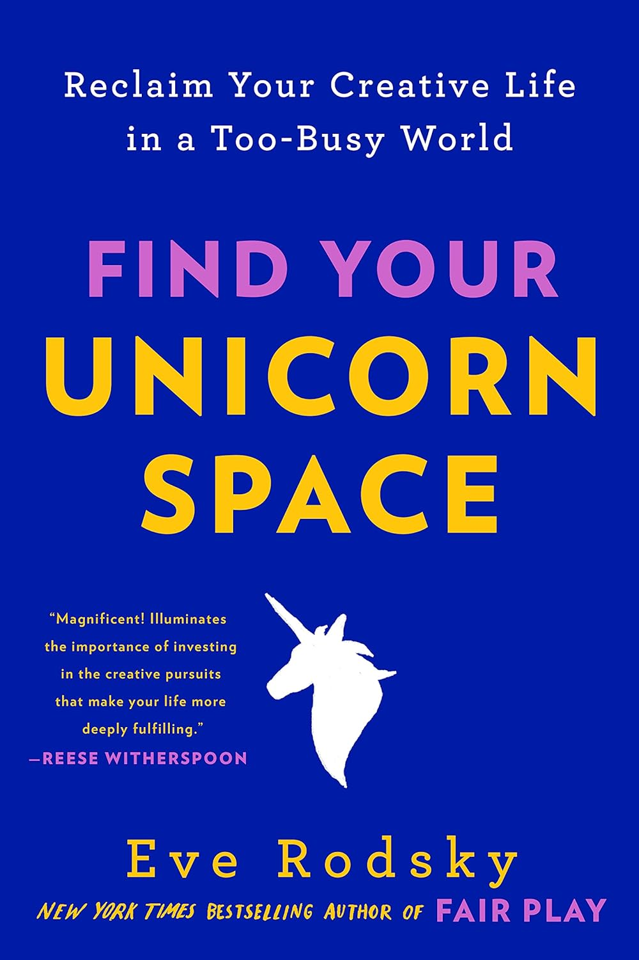
Training Family & Others to Respect your sacred Writing Time
“Don’t Crash My Party!”
Complete this prompt: “Building time into my daily/weekly schedule for writing is valuable to me because ________________________________________.”
Set a schedule and stick to it Set boundaries and establish routines to protect dedicated writing time
Pre-negotiate your creative space and time.
Mind your tone and listen Communicate the importance of writing time – it’s your ‘what’ and ‘why’ be sure to have ‘low-emotion, high-cognition dialogues.’
Clarify your ‘what’ and ‘why’ Your what is writing, make sure your why is understood. This is about how you feel when you are creating. How does it insulate you from the rest of your day, how does it impact on your relationships, workspace, productivity, and your emotional, physical, and mental state.
Collaboration and support Involve family members in the creative process by sharing writing progress, seeking feedback, or even collaborating on writing projects. Make loved ones your best cheer section. Celebrate milestones with a special treat.
IF all else fails
Notes:
Emphasize the positive impact that prioritizing writing can have on writers' mental health, career aspirations, and overall fulfillment.
Talking points for writers to use when discussing the importance of writing time with their family members and loved ones.
“6PM is Writing Power Hour, if you needs something ask your dad. I’m hanging my sign now and I’ll see you in a little bit. Thank you for respecting my time to focus.”
“Thursday night is my weekly critique group, and you have your bowling night every Tuesday. I love that we’ve got each other’s backs.”
“I will write for two hours every day between 9-11AM at the library while Emma is at preschool. My phone will be on DND.”
“Don’t crash my party!!!”
Explain to kids in a way that they will understand. Also ask them to share their own ‘whys’ for personal uninterrupted space and time. i.e. kids playing online video games with friends.
“Having this outlet energizes me. I wake up happier, which makes me a better partner/parent/employee.”

Slide 12
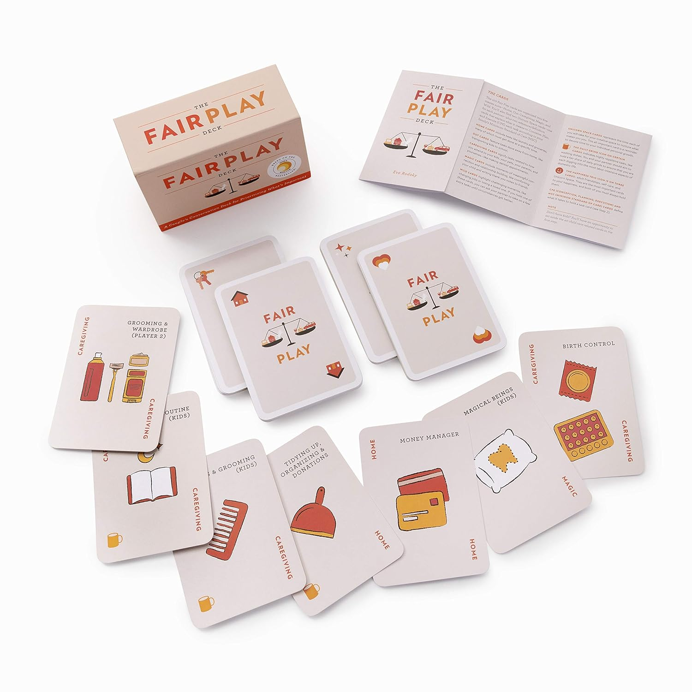
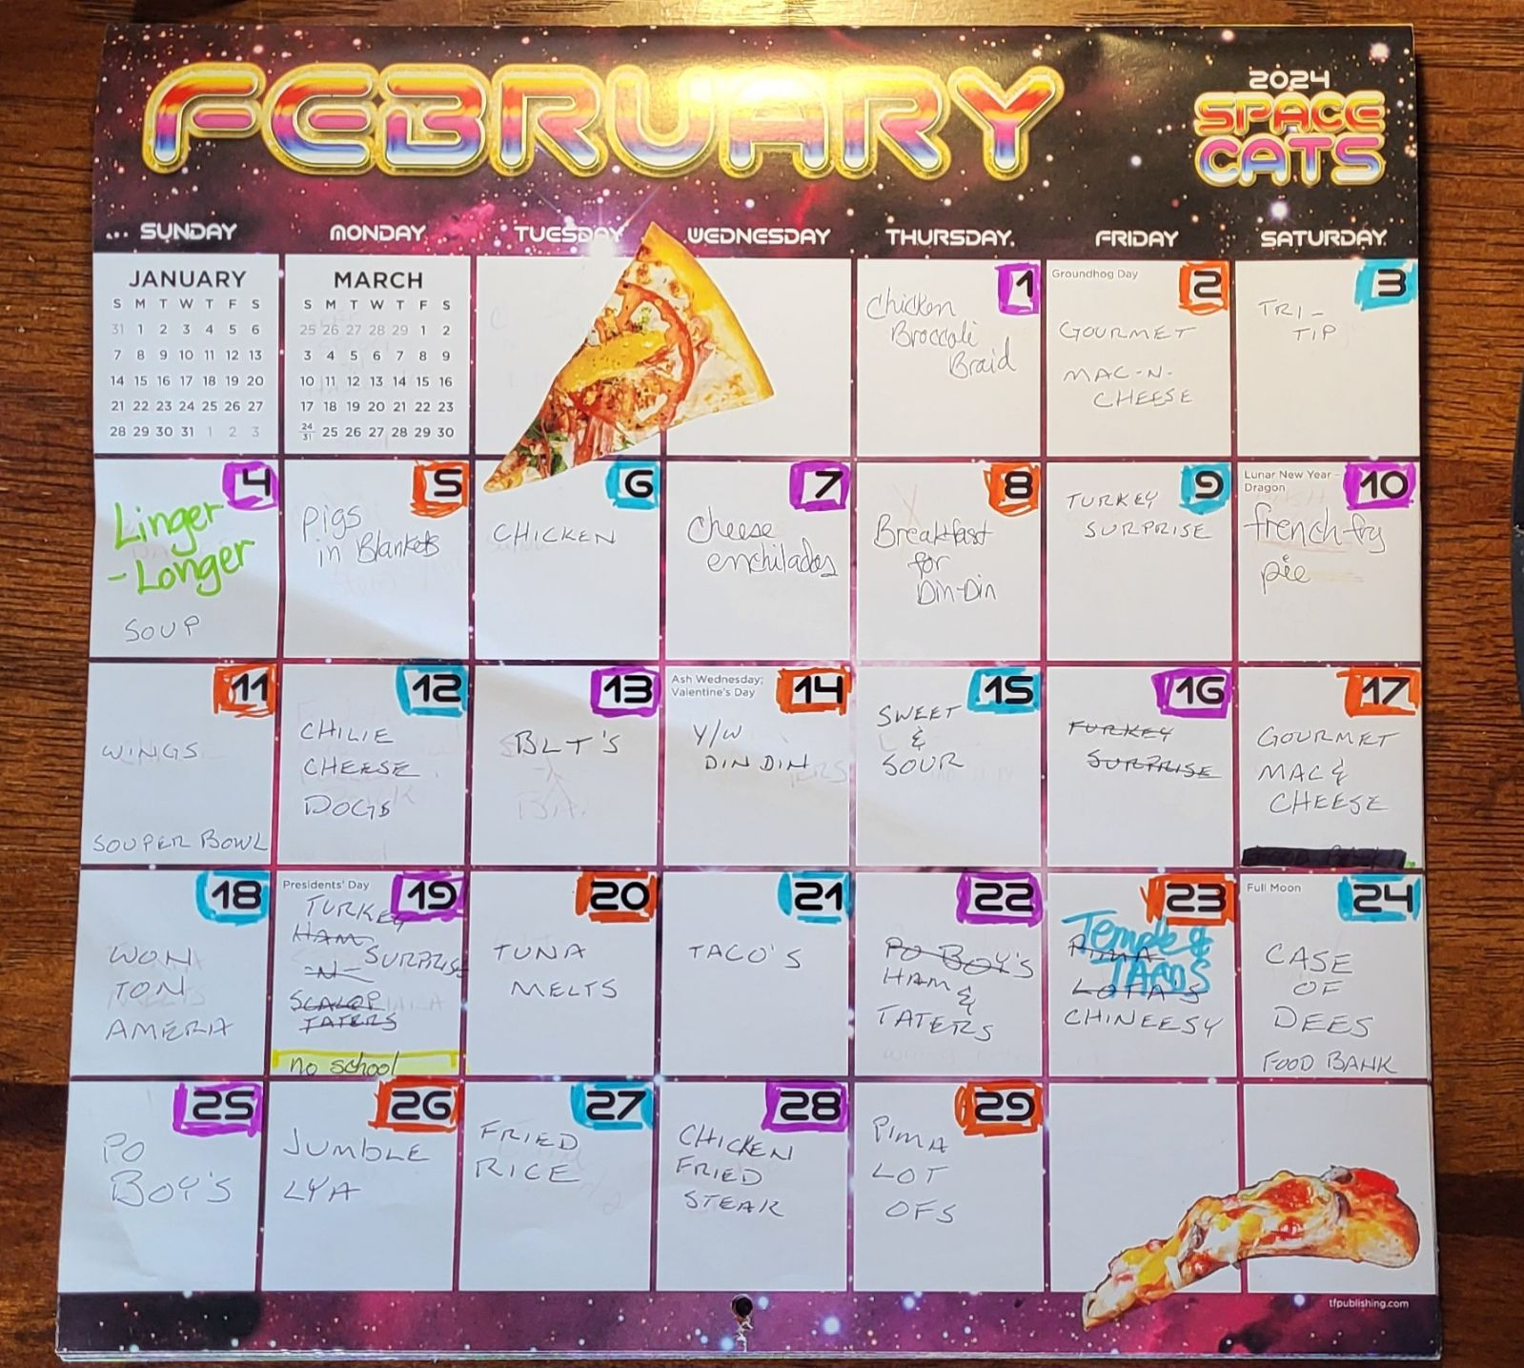
Employing Fair Workload Practices
The Fair Play System based on the book by the same name, involves identifying, delegating, and tracking tasks using a set of cards and a game-like framework and it is a structured approach to rebalancing household responsibilities.
Task Ownership: Each partner is assigned ownership of specific tasks based on their skills, interests, and preferences, allowing for a more equitable distribution of labor and a sense of ownership and accountability.
Transparent Communication: The Fair Play system promotes transparent communication and negotiation between partners, encouraging them to discuss their needs, expectations, and boundaries openly and respectfully.
Practical Applications: "Fair Play" provides practical strategies and tools for implementing the system in everyday life, including setting up regular check-ins, adjusting task allocations as needed, and celebrating achievements and milestones. It models positive examples for the children in the home and changes tasks from ‘women’s work’ to ‘we’re all in this together.’
Benefits of Fair Play: By adopting the Fair Play system, couples and families can experience improved communication, reduced conflict, and increased efficiency in managing household responsibilities, leading to greater satisfaction and well-being for all members.
Strategies for Equitable Distribution: Create a chore chart or schedule that rotates household responsibilities among family members on a weekly or monthly basis. Encourage open communication and flexibility to accommodate individual preferences and strengths.
Notes:
Fair Play addresses the unequal distribution of labor in households and the impact it has on relationships, well-being, and gender equality. It advocates for a fairer division of responsibilities to improve family dynamics and promote greater satisfaction and harmony. It also contributes to broader societal change by challenging traditional gender roles and promoting gender equality in the home and beyond.

Slide 13
Leveraging Personal Chronotypes
https://sleepdoctor.com/sleep-quizzes/chronotype-quiz/
Chronotypes are distinct biological rhythms. Understanding and honoring one's chronotype can lead to numerous benefits, including improved sleep quality, enhanced productivity and focus during peak performance times, better mood regulation, and overall well-being. By syncing their activities with their biological clock, individuals can unlock their full potential, achieve greater success, and live happier, healthier lives.
TIP: Scheduling writing sessions based on personal chronotypes enhances both creativity and focus. There are times of day for creative thinking, daydreaming, peak alertness for analytical thinking, and brainstorming.
Lion Chronotypes (morning people, 15-20%)
Neil Gaiman is known to be an early riser and prefers to start his writing sessions in the morning
Julie Berry, author of "Lovely War" and other bestselling novels, is also a morning person
Bear Chronotypes (midday people, 50-55%)
Brandon Sanderson, renowned fantasy author of the "Mistborn" series falls into the bear chronotype category
Wolf Chronotypes (evening people 15-20%)
Martine Leavitt, author of "Keturah and Lord Death" and other acclaimed novels, is a self-proclaimed night owl
Dolphin Chronotypes (erratic sleepers, 10-15%)
Orson Scott Card, author of the beloved "Ender's Game" series, is known for his adaptable writing habits
Notes:
"The Power of When" by Dr. Michael Breus explores the concept of chronotypes, which categorize individuals into distinct biological rhythms governing their sleep-wake patterns, energy levels, and peak performance times throughout the day. By identifying their chronotype—such as Lions (morning people), Bears (midday people), Wolves (evening people), or Dolphins (erratic sleepers)—readers can optimize their daily routines, work schedules, and lifestyle choices to align with their natural biological rhythms. Understanding and honoring one's chronotype can lead to numerous benefits, including improved sleep quality, enhanced productivity and focus during peak performance times, better mood regulation, and overall well-being. By syncing their activities with their biological clock, individuals can unlock their full potential, achieve greater success, and live happier, healthier lives.

Slide 14
Soquel's Daily Schedule (School year 2023-2024)
Time | TimeWise | Soquel/Dolphin Schedule
5:45 | Brainstorming | One Snooze
6:00 |  | Wake up - take meds, stretch for 10 minutes
6:15 |  | Write Morning Pages
6:30 |  | Take Adelaide to school
6:45 |  | Cool Shower - 1 minute affirmation/meditation
7:00 |  | High Protein BREAKFAST - Do NOT Skip!!!
7:15 |  | Dress/ Make-up
7:30 |  | Email/bills/menu planning
7:45 |  | Organize day/ Review Schedule
8:00 | Novel Writing | REPORT TO OFFICE/ CLOCK IN
8:15
8:30 |  | New WIPs
8:45
9:00 |  | Dr Pepper Break
9:15 |  | Resume wordcount
9:30
9:45
10:00 | Big Picture | Storyboard/Research/Daydream
10:15
10:30 |  | Critique Partner Time
10:45
11:00 |  | WritingTo-Do lists
11:15
11:30 |  | Video Tutorials
11:45 |  | Clock Out/ Record Progress
12:00 | Downtime | LUNCH - Do NOT Skip!!!
12:15 |  | Walk/ Dance
12:30
12:45 |  | Social Media/ TV Binge
13:00 |  | NO MORE DR PEPPER!
13:15 |  | Run Errands/Shop
13:30
13:45
14:00 | Brainstorming
14:15 |  | Pick Adelaide up from School
14:30 |  | Snack & Chat
14:45
15:00 |  | Busywork at desk
15:15 |  | Audiobooks & Puzzles
15:30
15:45
My Dolphin Writing Schedule
Morning Routine
18 hr. day broken into 15-minute increments
Workday Begins
Soquel's Daily Schedule (School year 2023-2024)
Time | TimeWise | Soquel/Dolphin Schedule Continued
16:00 | Revisions/Edits | Entering Peak Alertness CLOCK IN
16:15 |  | Prepping for Indy Career Path
16:30
16:45
17:00
17:15
17:30
17:45 |  | Clock Out/ Record Progress
18:00 | Mom | 15 minutes of Solitude Time
18:15 |  | Dinner prep/Homework Help
18:30
18:45
19:00 | Socialize | Dinner - Highest Carbs of day
19:15 |  | Family Scriptures/Come Follow Me
19:30 |  | Hard conversations
19:45 |  | Family Bonding
20:00 |  | DWENT/Book Club/RS
20:15 |  | TV with family
20:30
20:45
21:00 | Stimulus Control | Adelaide Bedtime
21:15 |  | Yoga/ Hot bath/Unwind
21:30
21:45 |  | Light reading/ TV/Puzzles
22:00
22:15
22:30
22:45
23:00 |  | Wrap it up
23:15 |  | Go to Bed
Niksen/Flow
Dolphin mealtimes
Second Creative Wave

Slide 15
Finding the Ideal Time to Write
Techniques for Identifying Ideal Writing Time: Based on personal preferences and commitments. Experiment with different writing schedules and pay attention to when they feel most alert, creative, and productive. Hint: Start with suggestions tailored to your chronotype.
Encouragement for Experimentation: View finding the ideal writing time as an ongoing experiment with different schedules and routines to find the optimal time for creative work rather than a fixed formula. It’s about self-discovery and self-awareness in refining writing habits and maximizing productivity over time.
Importance of Flexibility: Adapting writing schedules to changing circumstances and priorities is a must! Encourage writers to be open to adjusting their routines and routines to accommodate fluctuations in energy levels and external factors
“Write or do nothing!” Neil Gaiman
Master of Niksen & Flow
Notes:
First things first! Check out the book The Power of When and read the pages pertaining to your chronotype. There will be several specific suggestions for writers for you to try out.
Create a Writing Schedule: Establish a routine by scheduling regular writing sessions at the same time each day or week. Stick to your schedule to develop a habit of writing consistently and avoid procrastination
.
Note: This is your writing time based on your needs. Figure it out and then make arrangements to set this unicorn space in stone with your family. Once it’s there, maintain your boundaries. Revisit if necessary.

Slide 16
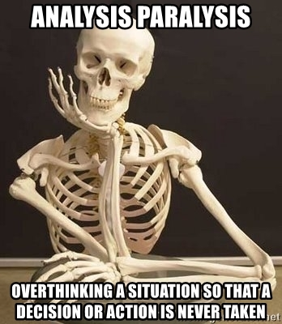
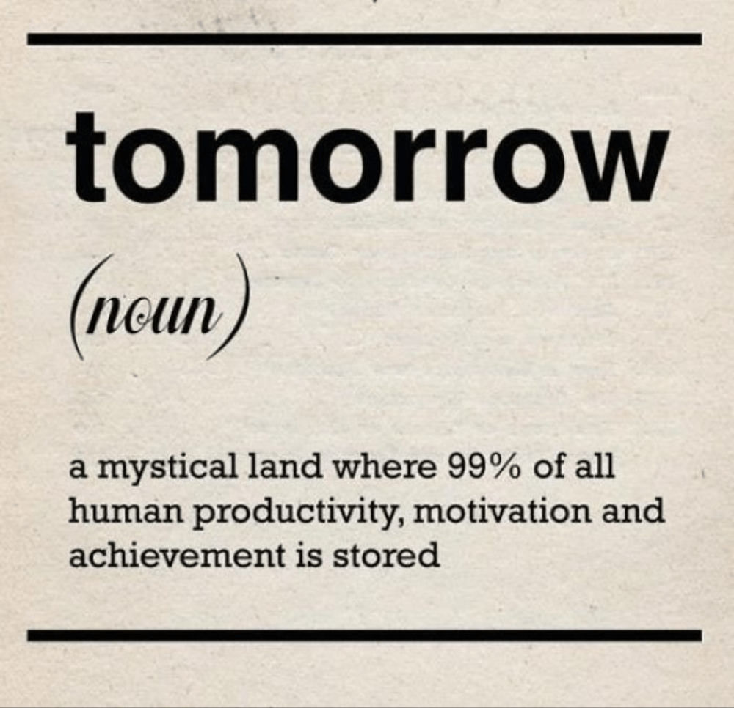
Overcoming time-wasting habits
Identification of Common Time-Wasting Habits: Such as procrastination, analysis paralysis, multitasking, and excessive perfectionism. Identify your own time-wasting behaviors and recognize the impact they have on your creative output.
Strategies for Breaking Free: Set deadlines, break tasks into smaller steps, delegate tasks that can be outsourced or automated, and practicing mindfulness to stay present and focused.
Cultivating Self-Awareness and Resilience: Stay focused on writing goals. Practice self-compassion and celebrate small victories as you work towards improving your time management skills.
“I’m a recovering perfectionist and an aspiring ‘good-enoughist.”
Brené Brown, The Gifts of Imperfection
Notes:
Analysis Paralysis: happens when we’re under the illusion that we need more and more information to actually get started. The fear of making mistakes causes us to freeze up and do nothing.
Strategies for overcoming procrastination and increasing productivity: using techniques like the Pomodoro Method or time blocking to manage time effectively. Develop a sense of urgency and take immediate action on important tasks to avoid procrastination and increase motivation.
Mindfulness and meditation: Encourage practicing mindfulness exercises and meditation to cultivate awareness of distractions and develop the ability to refocus attention on the present moment.
Digital detox: Suggest limiting screen time, disabling notifications, and scheduling designated periods for checking emails and social media to reduce digital distractions and regain control over attention.
Time management techniques: Introduce time-blocking, Pomodoro technique, and other time management tools to prioritize tasks, minimize procrastination, and maintain focus on important activities.
Environmental adjustments: Recommend creating a conducive work environment by minimizing noise, decluttering workspace, and using noise-cancelling headphones or white noise machines to block out distractions.

Slide 17
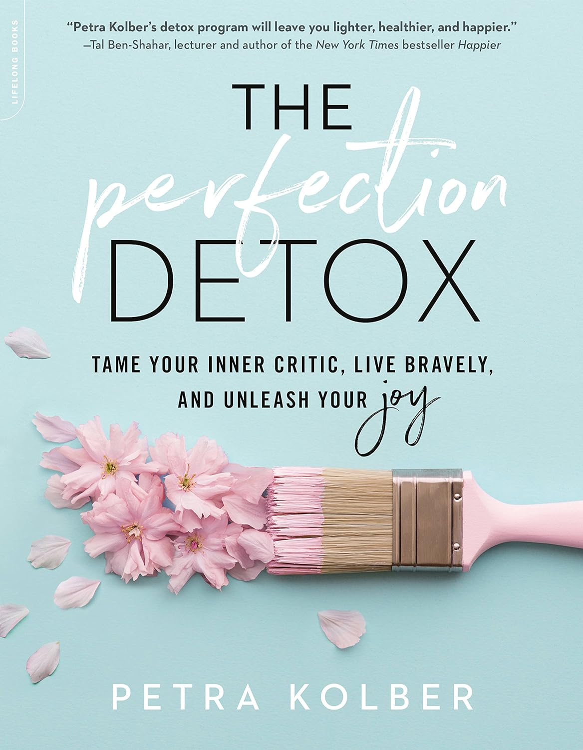
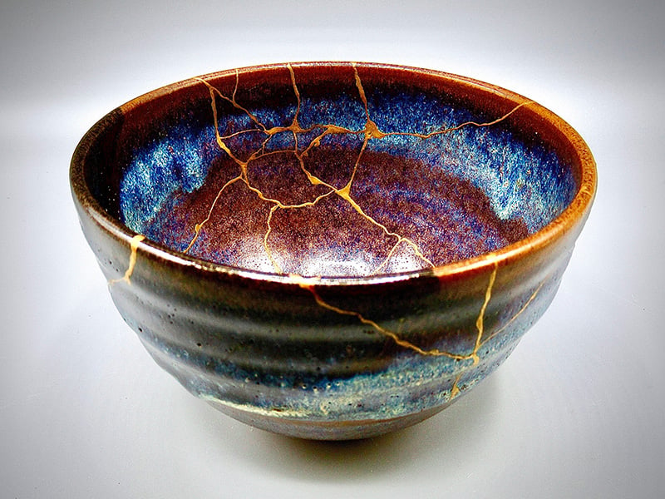
Embracing a balanced approach to time management
Importance of Balance: Avoid the dangers of overworking and burning out. Prioritize rest and relaxation to maintain creative energy and motivation. Use the “80/20 rule” - 80% essential tasks, 20% leisure and self-care activities.
Embrace Imperfection: Prioritize progress over perfection in your writing and time management efforts. Let go of unrealistic expectations and focus on continual growth and learning in the pursuit of productivity and creativity, cultivate self-compassion, growth-mindset, and acceptance. This is your ‘Grit’!!!
Prioritizing Self-Care: Incorporate well-being practices such as meditation, exercise, and leisure activities into writers' daily routines to recharge and rejuvenate.
Kintsugi & Wabi-Sabi
Notes:
Wabi-Sabi, y’all!!! Finding beauty in the imperfect.
Self-care – stretch and do desk yoga (as seen on YouTube)
Finding Balance and Avoiding Burnout: Discuss strategies for managing stress and avoiding becoming overwhelmed, such as prioritizing self-care, setting realistic expectations, and learning to say no to unnecessary commitments. Offer practical tips for maintaining balance, such as the 80/20 rule, where writers spend 80% of their time on essential tasks and 20% on leisure and self-care activities. Emphasize the importance of setting boundaries and recognizing the signs of burnout to prevent long-term negative effects on creativity and well-being.
"Grit" is a bestselling book by Angela Duckworth that explores the psychological trait of grit, defined as the combination of passion and perseverance towards long-term goals. It is a predictor of success, surpassing talent or intelligence in determining achievement. She delves into the factors that contribute to grit, such as mindset, effort, and resilience, and offers insights into how individuals can cultivate grit in themselves and others.
Perseverance: in the face of obstacles, setbacks, and failures, highlighting the role of grit in sustaining effort and motivation over the long term.
Resilience: the ability to bounce back from adversity and adapt to changing circumstances, emphasizing the role of grit in building resilience and overcoming adversity with determination and resilience.
Growth Mindset: believe that their abilities can be developed through effort and practice, rather than being fixed or innate. It can foster grit and facilitate achievement and success in various domains of life.

Slide 18
Implement a filing system for storing research materials, notes, and drafts related to your writing projects. Organize your digital files and folders in a logical manner to easily locate documents when needed. I love the heck out of Microsoft OneNote!

Slide 19
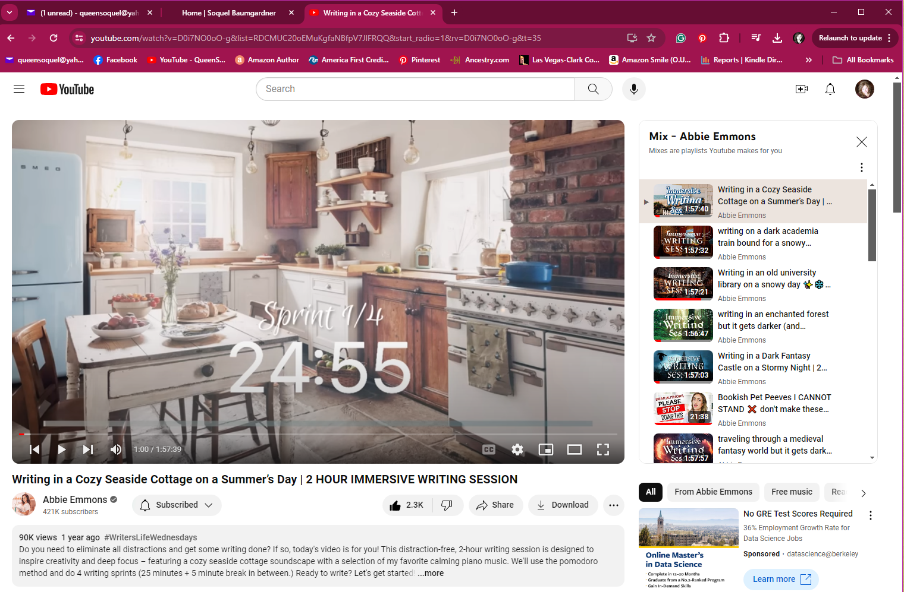
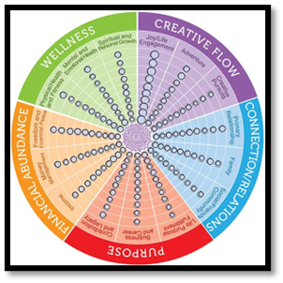
I love these fun timed sprints on YouTube! There’s something for every mood & genre!
The "work-life balance wheel" helps assess and prioritize different areas of life such as work, family, health, and hobbies. It’s helpful for nurturing each aspect and to prevent burnout and maintain overall well-being.
Notes:
None needed!

Slide 20
Review & Reflect
Regularly review your writing goals and assess your progress towards achieving them. Reflect on what strategies are working well for you and make adjustments as needed to improve your writing process.
By establishing boundaries, protecting writing time, and implementing best practices for organization, writers can create a conducive environment for creativity, productivity, and success in their writing endeavors.
Notes:
Thank you for coming to my class. Stay tuned for 4 Bonus slides of essential reads for balancing your time and creativity.

Slide 21
The Best Books for Maximizing Creativity
Notes:
"Niksen" encourages the practice of mindfulness by embracing moments of idleness and being present in the moment.
"Flow" explores the concept of being fully immersed in an activity, where one's focus is so intense that they lose track of time and self-consciousness.
"Unicorn Space" emphasizes the importance of creating mental space for creativity by being present and fully engaged with one's thoughts and ideas.
"Stolen Focus" discusses the detrimental effects of distractions on our ability to be present and focused, highlighting the need to reclaim our attention.
Embracing Stillness and Reflection:
"Niksen" promotes the value of embracing stillness and allowing the mind to wander freely without a specific purpose.
"Flow" suggests that moments of reflection and relaxation are essential for achieving optimal performance and creativity.
"Unicorn Space" encourages individuals to carve out time for reflection and introspection, allowing ideas to incubate and develop.
"Stolen Focus" warns against the constant busyness and multitasking culture that impedes our ability to engage in deep reflection and contemplation.
Balancing Activity and Rest:
"Niksen" advocates for finding a balance between activity and rest by incorporating moments of "doing nothing" into daily life.
"Flow" suggests that optimal experiences occur when there is a balance between challenge and skill, requiring periods of both intense activity and relaxation.
"Unicorn Space" emphasizes the importance of rest and relaxation in replenishing creative energy and preventing burnout.
"Stolen Focus" highlights the need to prioritize rest and recovery to combat the negative effects of constant digital distractions and information overload.
Cultivating Creativity and Productivity:
"Niksen" suggests that moments of idleness can spark creativity and lead to innovative thinking.
"Flow" proposes that achieving a state of flow leads to increased creativity, productivity, and satisfaction with one's work.
"Unicorn Space" encourages individuals to create environments conducive to creativity by minimizing distractions and embracing periods of solitude.
"Stolen Focus" underscores the importance of protecting one's focus and attention in order to maximize productivity and creativity in an increasingly distracted world.

Slide 22
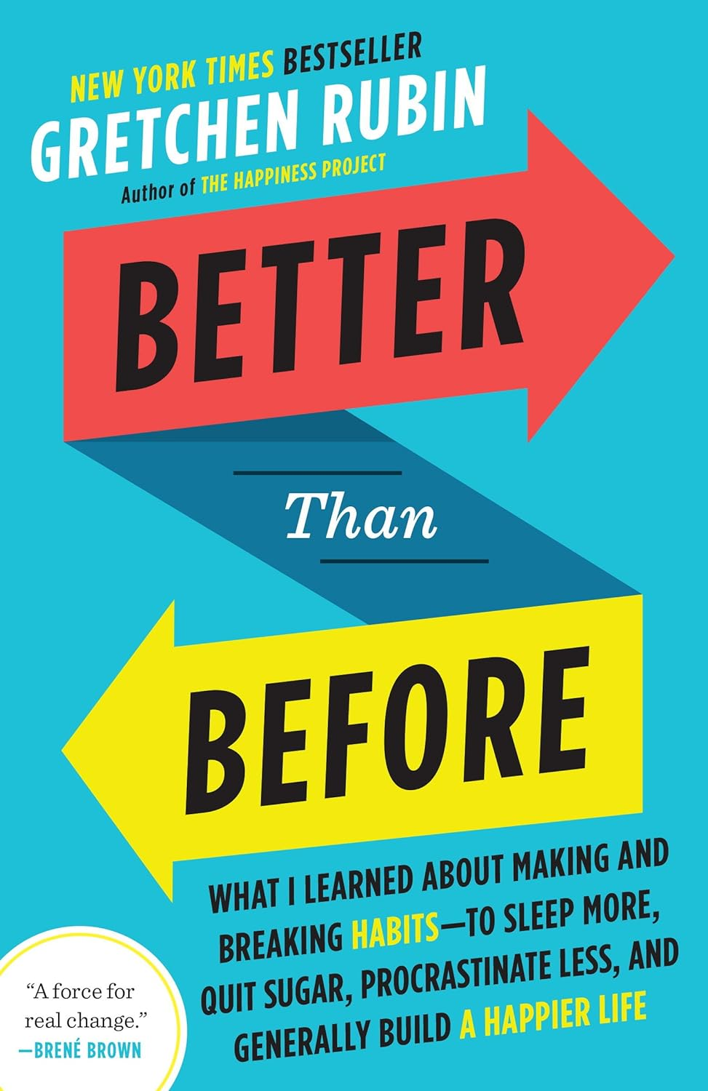
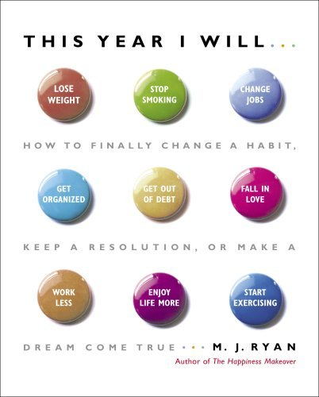
The Best Books for Habit Formation
Notes:
Understanding Habits:
Each book delves into the psychology and science behind habits, exploring how they are formed, maintained, and changed.
Authors emphasize the importance of recognizing habits as automatic behaviors that shape our daily lives and overall outcomes.
Habit Formation and Change:
Authors provide insights into how habits are formed through the habit loop (cue, routine, reward), and offer strategies for changing habits by targeting each component.
They discuss the role of cues, cravings, and rewards in habit formation, and how modifying these elements can lead to lasting behavior change.
Small Changes, Big Impact:
All books advocate for the power of small, incremental changes in shaping habits and achieving significant results over time.
Authors emphasize the concept of "atomic habits"—tiny changes that compound over time to produce remarkable outcomes in behavior and life.
Habit Stacking and Environment Design:
Authors discuss techniques such as habit stacking (linking new habits to existing ones) and environment design (structuring surroundings to support desired behaviors) to facilitate habit formation and change.
They highlight the importance of optimizing environments for success by removing obstacles and creating cues that prompt desired behaviors.
Consistency and Persistence:
Authors stress the importance of consistency and persistence in habit formation and change, emphasizing the need for dedication and effort over time.
They encourage readers to focus on progress, not perfection, and to cultivate resilience in the face of setbacks and challenges.
Mindfulness and Self-awareness:
Each book underscores the role of mindfulness and self-awareness in recognizing habits, understanding triggers, and making intentional choices.
Authors discuss the importance of self-reflection, monitoring habits, and staying mindful of behavior patterns to facilitate change.
Personalization and Accountability:
Authors acknowledge that habit change is a personal journey, and encourage readers to customize strategies based on their unique preferences, values, and circumstances.
They discuss the importance of accountability and support systems in sustaining habit change, whether through tracking progress, seeking external accountability, or building social support networks.
Overall, "Atomic Habits," "The Power of Habit," "Better Than Before," and "This Year I Will... How to Finally Change a Habit" share common themes related to understanding, forming, and changing habits through small changes, environmental optimization, consistency, mindfulness, personalization, and accountability. These books offer valuable insights and practical strategies for readers seeking to cultivate positive habits and achieve lasting behavior change in their lives.

Slide 23
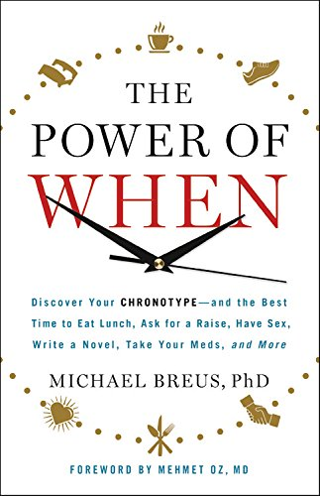
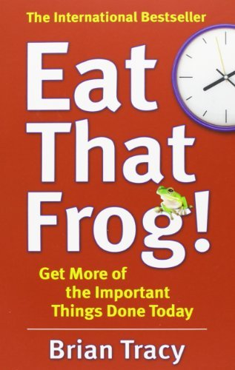
The Best Books for Maximizing Productivity
Notes:
Time Management and Prioritization:
Each book emphasizes the importance of managing time effectively and prioritizing tasks based on their significance and impact.
Authors offer strategies for setting clear goals, identifying priorities, and allocating time and resources accordingly to maximize productivity and achieve desired outcomes.
Focus and Productivity:
Authors discuss the importance of maintaining focus and avoiding distractions in order to accomplish meaningful work.
They offer techniques for minimizing interruptions, staying organized, and managing energy levels to sustain productivity throughout the day.
Optimizing Peak Performance:
Maximizing peak performance is a common theme, as authors explore how to align tasks with natural rhythms and energy levels for optimal results.
They discuss the concept of chronotypes, peak performance times, and strategies for scheduling activities based on individual preferences and biological rhythms.
Developing Resilience and Perseverance:
Building resilience and perseverance are recurring themes, as authors emphasize the importance of resilience in overcoming obstacles and setbacks on the path to success.
They discuss the role of grit—the combination of passion and perseverance—in achieving long-term goals and navigating challenges with determination and resilience.
Embracing Procrastination and Taking Action:
Authors address the tendency to procrastinate and offer strategies for overcoming procrastination and taking action on important tasks.
They advocate for techniques such as the "frog method" of tackling the most challenging tasks first and breaking tasks into smaller, manageable steps to overcome procrastination and achieve progress.
Mindful Time Management:
Mindfulness and intentionality in time management are emphasized, as authors encourage readers to cultivate awareness of how they spend their time and to make intentional choices aligned with their values and goals.
They offer techniques for practicing mindfulness, setting boundaries, and creating space for meaningful activities that nourish the mind, body, and spirit.
Balancing Work and Life:
Achieving work-life balance is a common theme, as authors discuss strategies for balancing professional responsibilities with personal priorities and self-care.
They emphasize the importance of setting boundaries, prioritizing self-care, and creating space for leisure, relationships, and activities that bring joy and fulfillment.
Overall, "4,000 Weeks," "Grit," "The Power of When," and "Eat That Frog!" share common themes related to time management, prioritization, focus, productivity, resilience, taking action, mindful time management, and achieving work-life balance. These books offer valuable insights and practical strategies for readers seeking to optimize their time, maximize productivity, and achieve success in both their personal and professional lives.

Slide 24
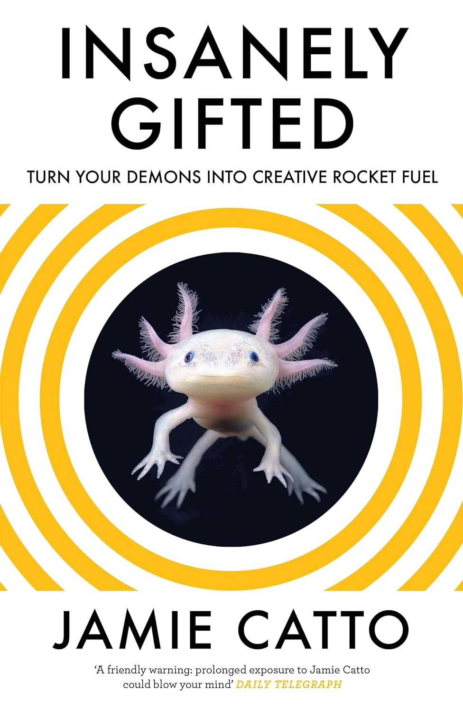
The Best Books for Overcoming Imposter Syndrome
Notes:
Embracing Authenticity and Imperfection:
Each book emphasizes the importance of embracing authenticity, imperfection, and vulnerability as pathways to personal growth and fulfillment.
Authors advocate for letting go of perfectionism, self-doubt, and the need for external validation in order to unlock creativity and live wholeheartedly.
Cultivating Self-Awareness and Mindfulness:
Authors discuss the importance of cultivating self-awareness and mindfulness in recognizing internal saboteurs, overcoming fear, and making intentional choices.
They emphasize the role of self-reflection, meditation, and other mindfulness practices in fostering resilience, clarity, and creativity.
Unlocking Creative Potential:
Creativity is a central theme across all books, highlighting its transformative power for personal expression, innovation, and self-discovery.
Authors encourage readers to embrace their unique gifts, tap into their creative impulses, and explore new possibilities with curiosity and courage.
Overcoming Fear and Resistance:
Fear and resistance are common obstacles addressed in each book, whether it's fear of failure, rejection, or inadequacy.
Authors offer strategies for confronting and overcoming fear, self-doubt, and limiting beliefs that hinder personal growth and creative expression.
Finding Joy and Fulfillment:
Authors advocate for pursuing passions, following curiosity, and seeking joy and fulfillment in everyday life.
They discuss the importance of prioritizing self-care, setting boundaries, and creating space for creativity and self-expression to flourish.
Building Resilience and Self-Compassion:
Building resilience and practicing self-compassion are recurring themes, as authors emphasize the importance of bouncing back from setbacks with kindness and grace.
They encourage readers to embrace failures and setbacks as opportunities for growth, learning, and self-discovery.
Letting Go of Comparison and External Validation:
Authors caution against comparing oneself to others and seeking external validation for self-worth and creativity.
They emphasize the value of embracing one's unique journey, trusting intuition, and staying true to oneself without seeking approval from others.
Overall, "Positive Intelligence," "Big Magic," "Insanely Gifted," "The Gifts of Imperfection," and "The Perfection Detox" share common themes related to embracing authenticity, cultivating creativity, overcoming fear and resistance, finding joy and fulfillment, building resilience, and letting go of perfectionism and external validation. These books offer valuable insights and practical strategies for readers seeking to cultivate a more authentic, creative, and fulfilling life.

